Slide 1

Final Internship Training Project
Presenter :- Sameer Wadkar

Slide 2
Overview
Action
Appendix

Slide 3
Overview
Exercise 1 :
This dataset contains household level transactions over two years from a group of 2,500 households who are frequent shoppers at a retailer. It contains all of each household’s purchases, not just those from a limited number of categories. For certain households, demographic information as well as direct marketing contact history are included.
Exercise 2 :
API Integration
API Integration is one of the important things to be managed when working with real time datasets. In this exercise you will be sourcing data from an api and displaying the results in the Power BI report.

Slide 4
Exercise 1
Things to be Done:
Load the CSV files to the database tables using python.
In SQL database
Add is_invalid_date column which indicates True or False based on the condition where start_day is greater than end_day.
Create start_datekey and end_datekey with yyyymmdd format based on start_day and end_day.
Normalize campaign_table into 2 tables.
Combine coupon and coupon_redempt tables into one Coupon table.
Find/ Create all the primary keys and foreign keys.
Build an ER model diagram using Lucid chart.
Connect to Power BI and build sample visualisaztion.

Slide 5
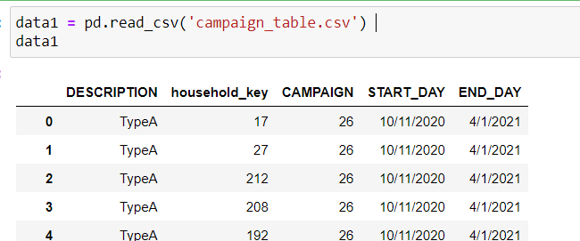
1. Load the CSV files to the database tables using python.
import pandas as pd
import sqlalchemy
data1 = pd.read_csv('campaign_table.csv’)

Slide 6
We need to create Python connection with SQL Server.
Below code used for building Python connection to load data in SQL server.
connection_string = ('Driver=ODBC Driver 17 for SQL Server;'
'Server=SWADKA01PC0922\SQLEXPRESS;'
'Database=Final_Project;'
'Trusted_Connection=yes;')
connection_url = sqlalchemy.engine.URL.create("mssql+pyodbc",query=dict(odbc_connect=connection_string))
engine = sqlalchemy.create_engine(connection_url, fast_executemany=True)

Slide 7
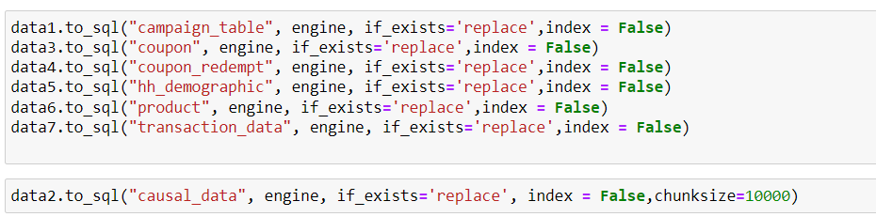
To load the data in SQL server

Slide 8
2. In SQL database
Add is_invalid_date column which indicates True or False based on the condition where start_day is greater than end_day.
Create start_datekey and end_datekey with yyyymmdd format based on start_day and end_day.
Normalize campaign_table into 2 tables.
Combine coupon and coupon_redempt tables into one Coupon table.

Slide 9
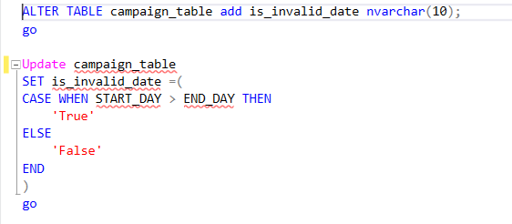
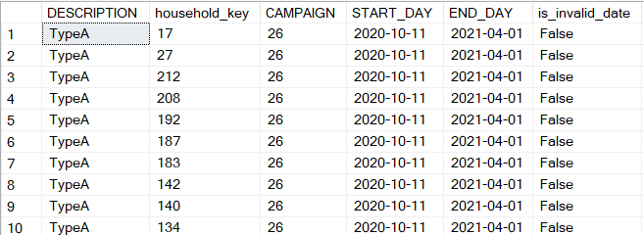
a. Add is_invalid_date column which indicates True or False based on the condition where start_day is greater than end_day.

Slide 10
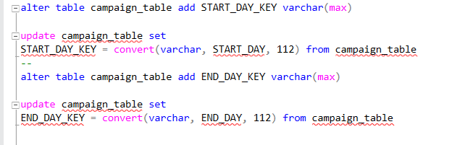
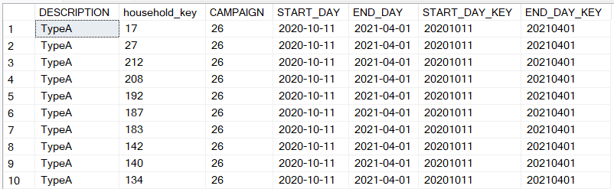
b. Create start_datekey and end_datekey with yyyymmdd format based on start_day and end_day.

Slide 11

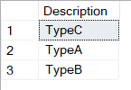
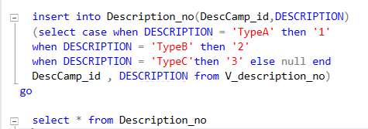
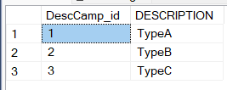
c. Normalize campaign_table into 2 tables.
Created two separate tables.
1. description_no

Slide 12
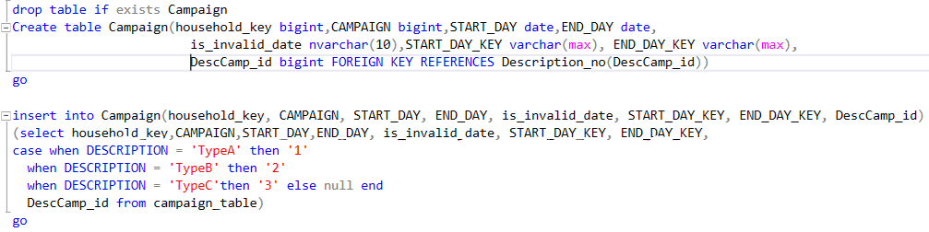
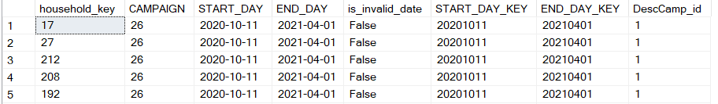
c. Normalize campaign_table into 2 tables.
Created two separate tables.
2. Campaign

Slide 13
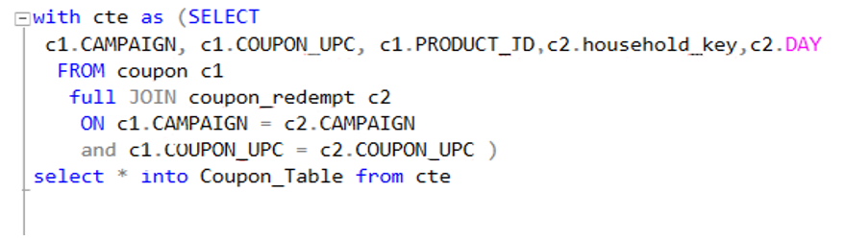
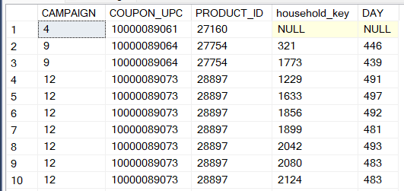
d. Combine coupon and coupon_redempt tables into one Coupon table.

Slide 14
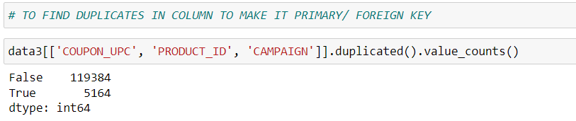
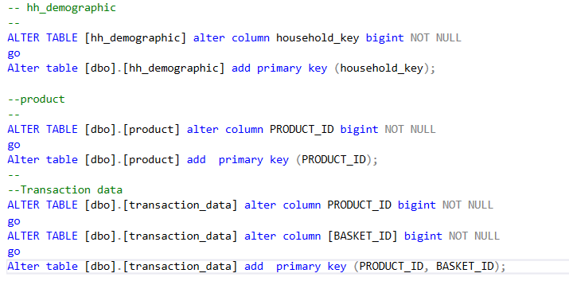
3. Find/ Create all the primary keys and foreign keys.
To create the primary or foreign key in tables, need to check if there is any duplicate values in column.
Here, False shows unique records.
And True shows duplicate recods.

Slide 15
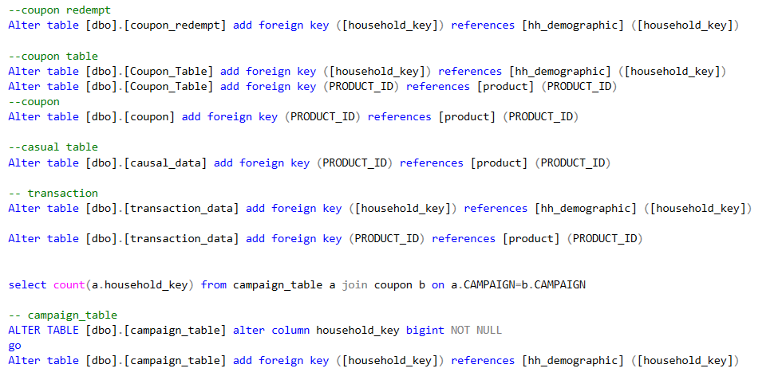
3. Find/ Create all the primary keys and foreign keys.

Slide 16
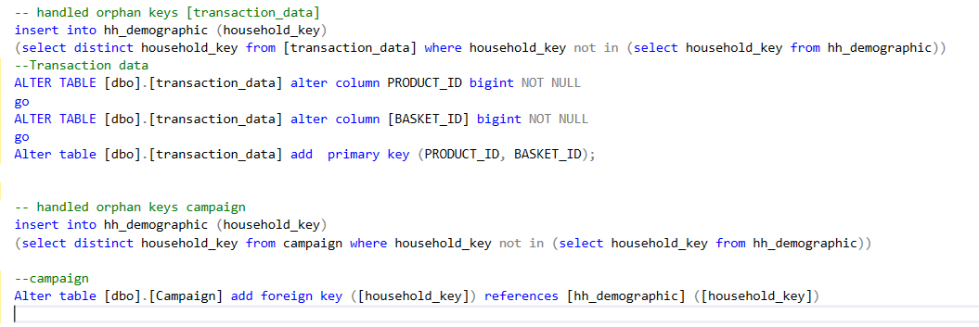
3. Find/ Create all the primary keys and foreign keys.
While in transaction_data and Campaign case need to handle the orphan keys

Slide 17
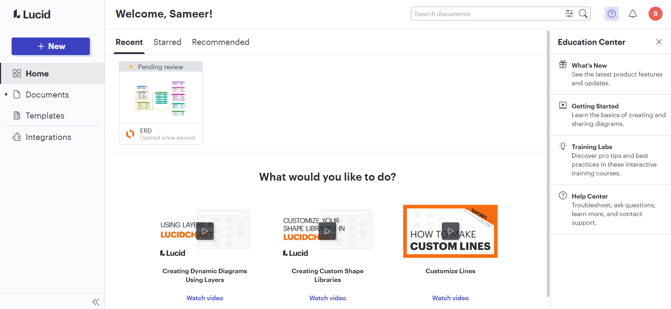
4. Build an ER model diagram using Lucid chart.
Click to open Lucid Chart web site.
After sign in, for the first time you will get below window.

Slide 18
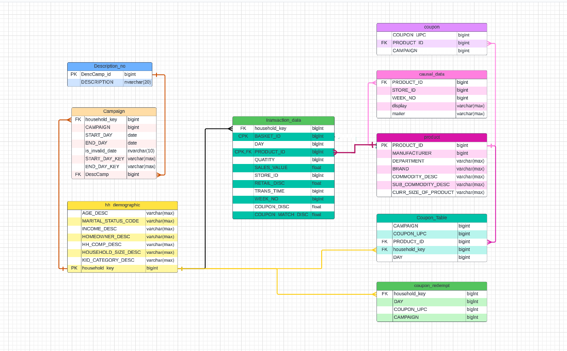
4. Build an ER model diagram using Lucid chart.

Slide 19
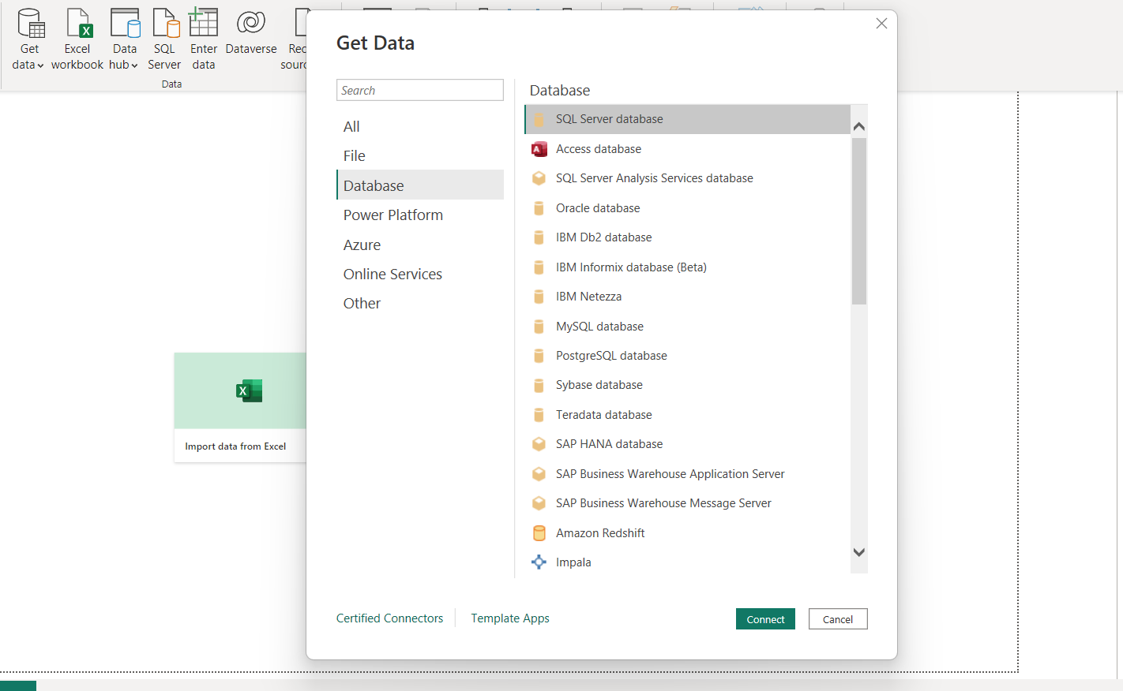
5. Connect to Power BI and build sample visualization.
For getting the data in Power Bi, we need to Import it by using Get data option.

Slide 20
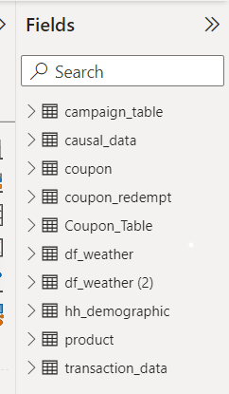
5. Connect to Power BI and build sample visualization.
In Fields section in Power Bi, we get imported data.

Slide 21
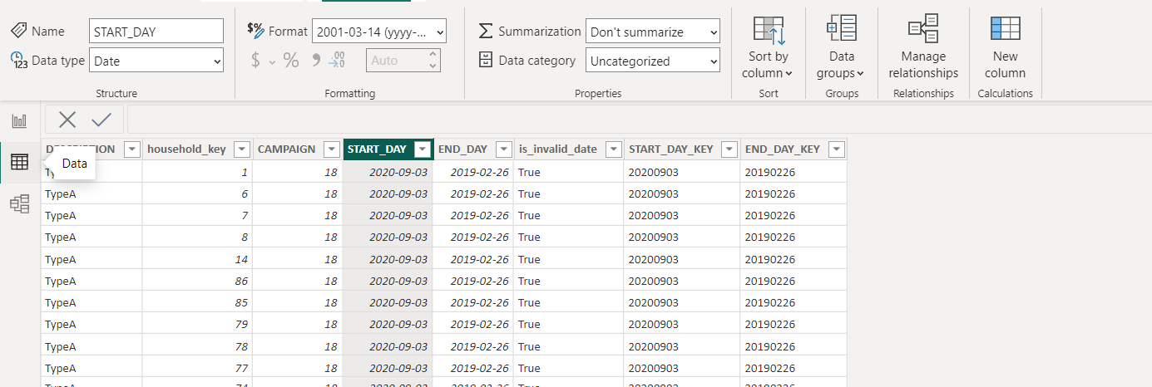
5. Connect to Power BI and build sample visualization.
Before start doing visuals in power Bi, need to check and if necessary, change the format or data type in Data section.

Slide 22
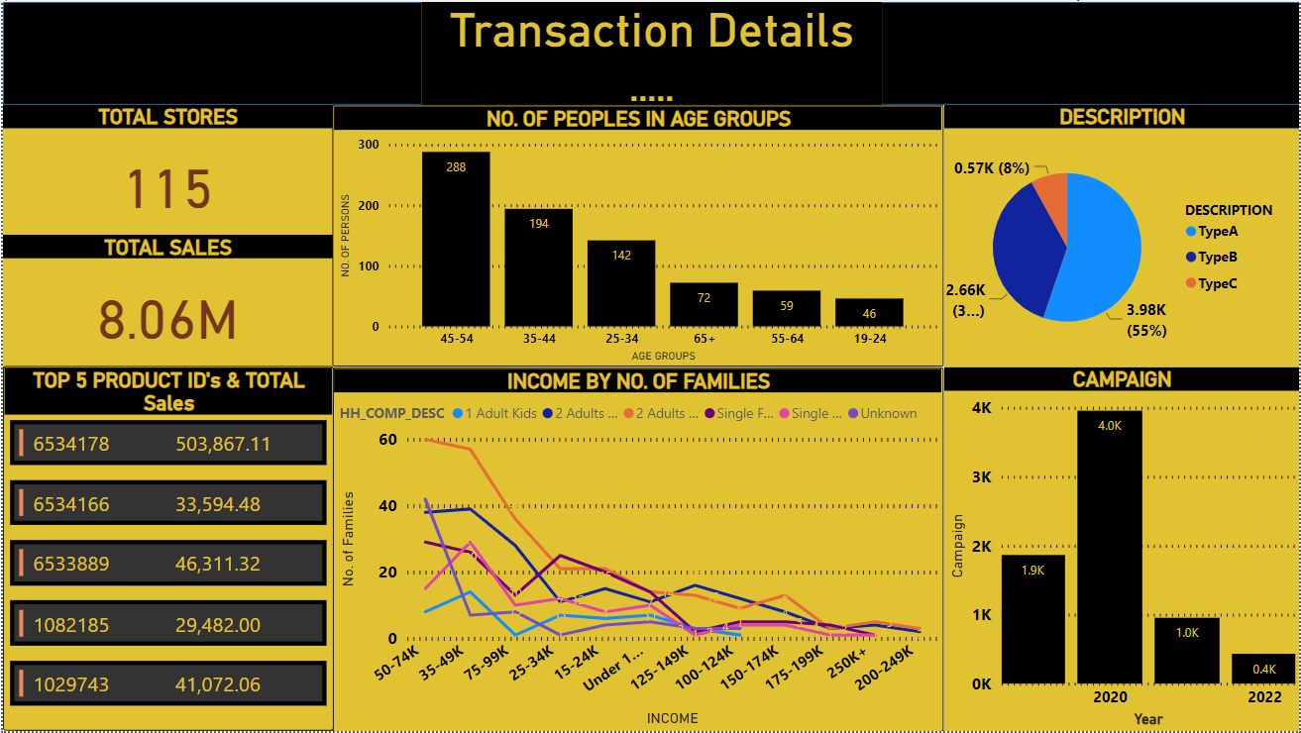
5. Connect to Power BI and build sample visualization.

Slide 23
Exercise 2
Things to be Done:
Source the data from the api : https://openweathermap.org.
Read the api documentation and display the weather of the Bangalore in the Power BI dashboard.

Slide 24
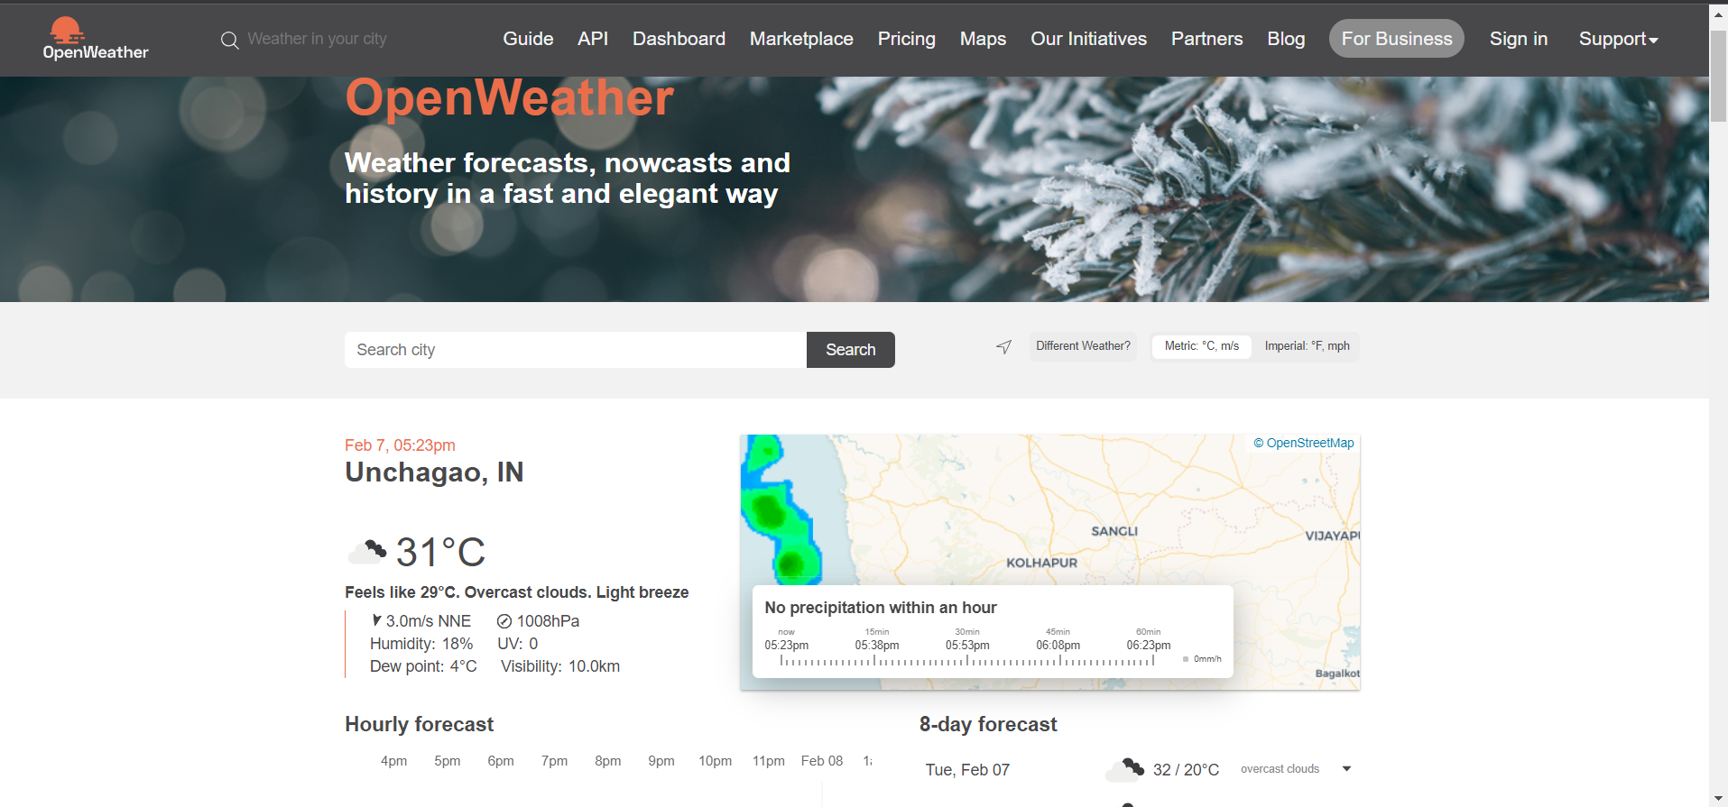
Source the data from the api : https://openweathermap.org.
Clicking on link we’ll directed towards below page. Need to sign in there first.

Slide 25
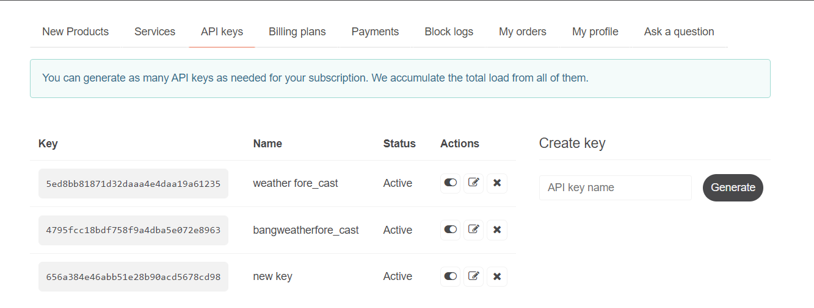
After Sign in. we’ll see option for API Key’s.
We can create new Key’s over here.

Slide 26
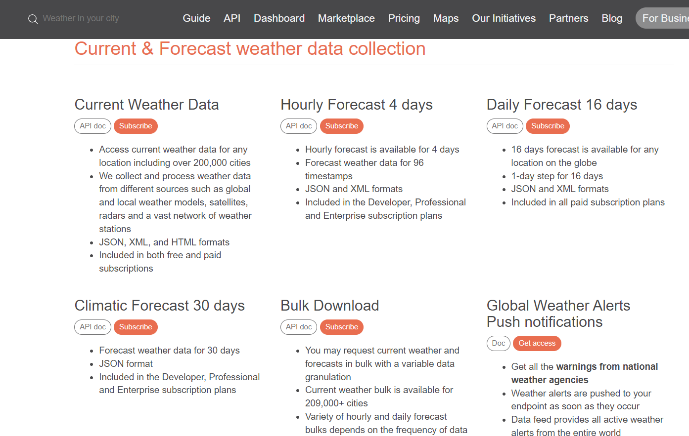
Click on API and select data collection as per requirement.

Slide 27
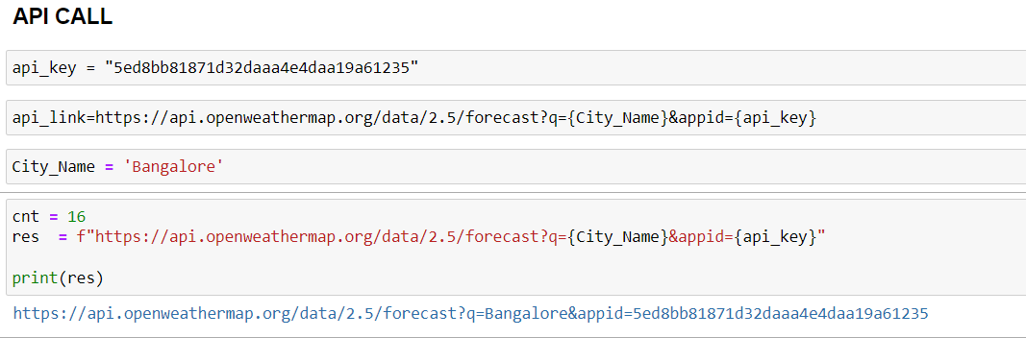

Slide 28
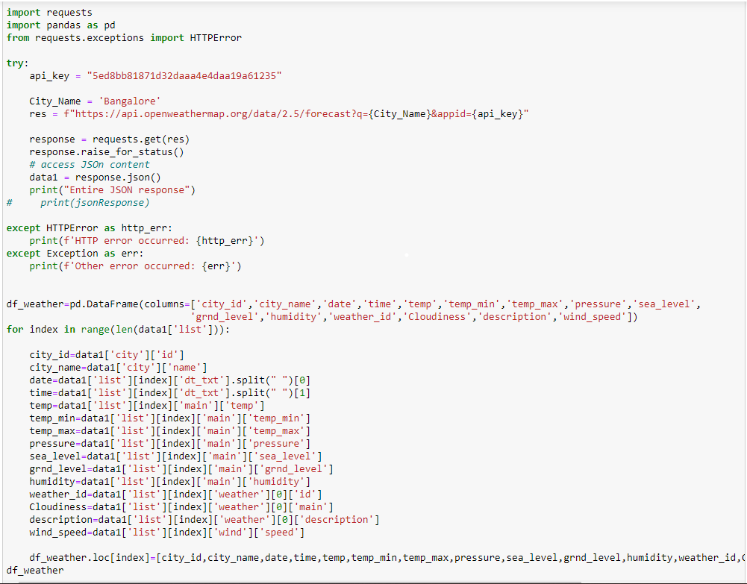
As per my requirement I get forecast data and just took 5 days data, for that I used below code.

Slide 29
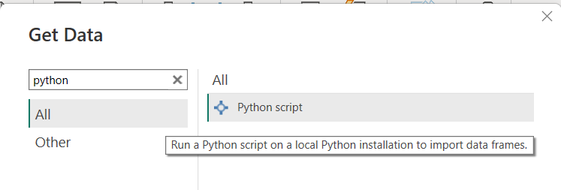
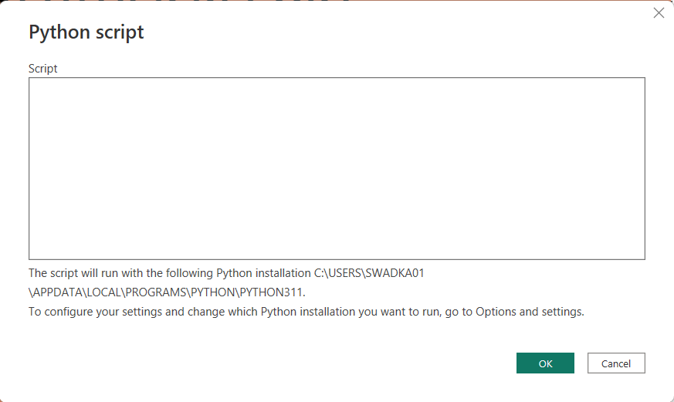
That python script we need to run on Power Bi.
On Power Bi, click on Get Data -> Python script -> Click connect option.
After that Python script prompt will open.
There we need to paste the script we created.

Slide 30
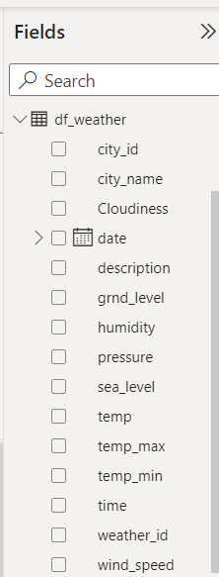
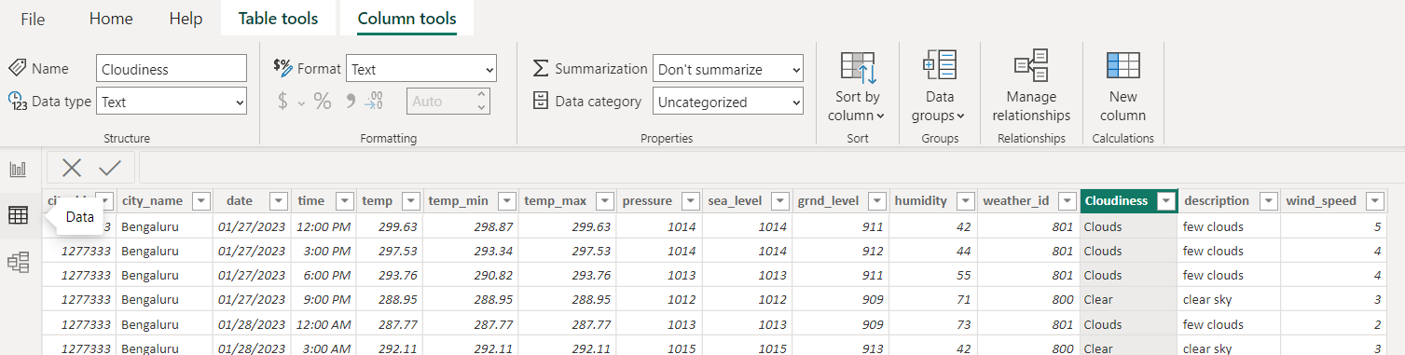
After running the python script in Power Bi, we can see the data in Fields.
And in Data section shown below we can change the data type of each fields.

Slide 31
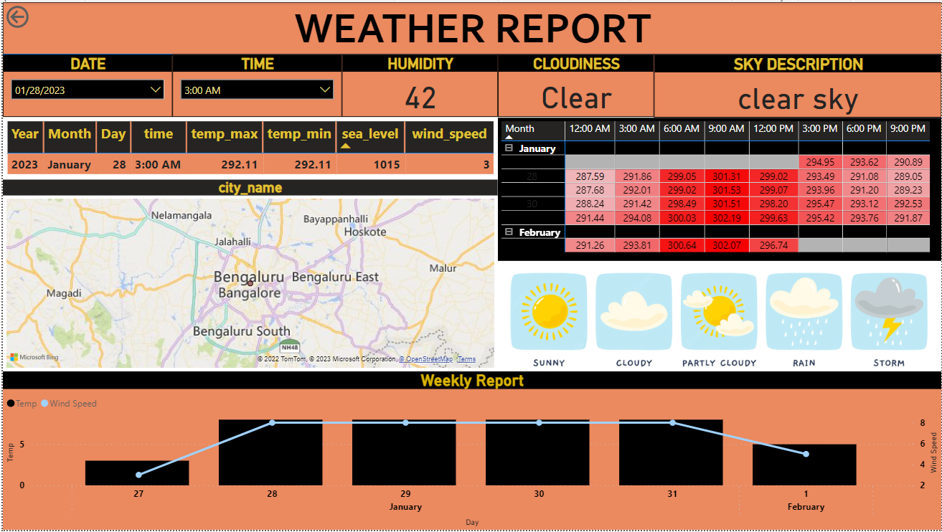
After setting correct datatype and by using some visuals, I have created Following Power bi report.

Slide 32

Questions?

Slide 33






Sameer Wadkar
Data Engineer(Analyst)
swadka01@atkearney.com
Stay connected with Kearney

